Slide 1
Information Extraction/Text Mining
Liya Wang
IST 664
NLP Application Investigation

Slide 2
Information Extraction & Text Mining and NLP
Information Extraction: is the task of automatically extracting structured information from unstructured and/or semi-structured machine-readable documents. In most of the cases this activity concerns processing human language texts by means of natural language processing (NLP).
Text Mining: also referred to as text data mining, roughly equivalent to text analytics, is the process of deriving high-quality information from text.
Natural language processing (NLP) is a field of computer science, artificial intelligence and computational linguistics concerned with the interactions between computers and human (natural) languages, and, in particular, concerned with programming computers to fruitfully process large natural language corpora.
Tasks in Information Extraction are Named entity recognition, Relationship extraction, etc.
Named entity recognition: recognition of known entity names (for people and organizations), place names, temporal expressions, and certain types of numerical expressions, by employing existing knowledge of the domain or information extracted from other sentences.
Relationship extraction: identification of relations between entities,
such as : PERSON works for ORGANIZATION (extracted from the sentence "Bill works for IBM.")
PERSON located in LOCATION (extracted from the sentence "Bill is in France.")
In this study, I would like to introduce three kinds of software: ReVerb and Ollie (used for Relationship extraction), Geotext and Quantulum (used for
Named entity recognition) and Eventregistry (used for Named entity recognition and text mining).
All software packages are through Natural Language Processing method, written by Java or Python languages and dealing with human languages.
From my understanding, in most cases of Information Extraction and Text Mining, NLP is the main part.

Slide 3
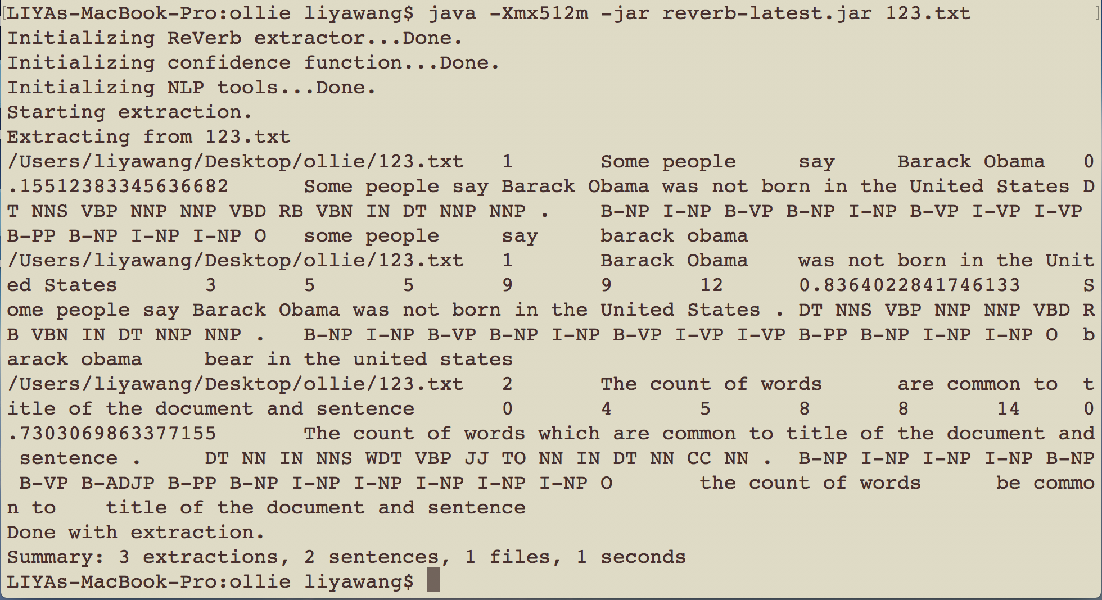
ReVerb – Binary Relationship Extraction
ReVerb is a program that automatically identifies and extracts binary relationships from English sentences. ReVerb is designed for Web-scale information extraction, where the target relations cannot be specified in advance and speed is important.
ReVerb takes raw text as input, and outputs (argument1, relation phrase, argument2) triples. For example, given the sentence "Bananas are an excellent source of potassium," ReVerb will extract the triple (bananas, be source of, potassium).
Pros: Fast analysis speed; best for simple sentences’ analysis
Software running procedure:
Download the latest ReVerb jar from http://reverb.cs.washington.edu/reverb-latest.jar
Run Screen Shot 2017-11-28 at 10.30.33 PM.
java -Xmx512m -jar reverb-latest.jar -h for more options.
Testing example: Tested two simple sentences.
From the right graph, we can see ReVerb results show the first event’s position
in the Extraction, the extractions(Some people, say, Barack Obama), the original
Sentences, pos tags and rules, and a summary (number of extractions, total
Sentences, files and analysis time.
Homepage: http://reverb.cs.washington.edu/
ReVerb’s extraction demo testing page: http://openie.allenai.org/
Github: https://github.com/knowitall/reverb
For more information about Building,
command Line Interface, Java Interface,
please seen in the Github

Slide 4
Ollie – Binary Relationship Extraction
Ollie is a program that automatically identifies and extracts binary relationships from English sentences. Ollie is designed for Web-scale information extraction, where target relations are not specified in advance.
Ollie is our second-generation information extraction system . Whereas ReVerb operates on flat sequences of tokens, Ollie works with the tree-like (graph with only small cycles) representation using Stanford's compression of the dependencies. This allows Ollie to capture expression that ReVerb misses, such as long-range relations.
Ollie also captures context that modifies a binary relation. Presently Ollie handles attribution (He said/she believes) and enabling conditions (if X then).
Pros:
Enabling Condition: An enabling condition is a condition that needs to be met for the extraction to be true. Certain words demark an enabling condition, such as "if" and "when". Ollie captures enabling conditions if they are present.
Attribution: An attribution clause specifies an entity that asserted an extraction and a verb that specifies the expression. Ollie captures attributions if they are present.
Relational noun: Some relations are expressed without verbs. Ollie can capture these as well as verb-mediated relations.
N-ary extractions: Often times similar relations will specify different aspects of the same event. Since Ollie captures long-range relations it can capture N-ary extractions by collapsing extractions where the relation phrase only differs by the preposition.

Slide 5
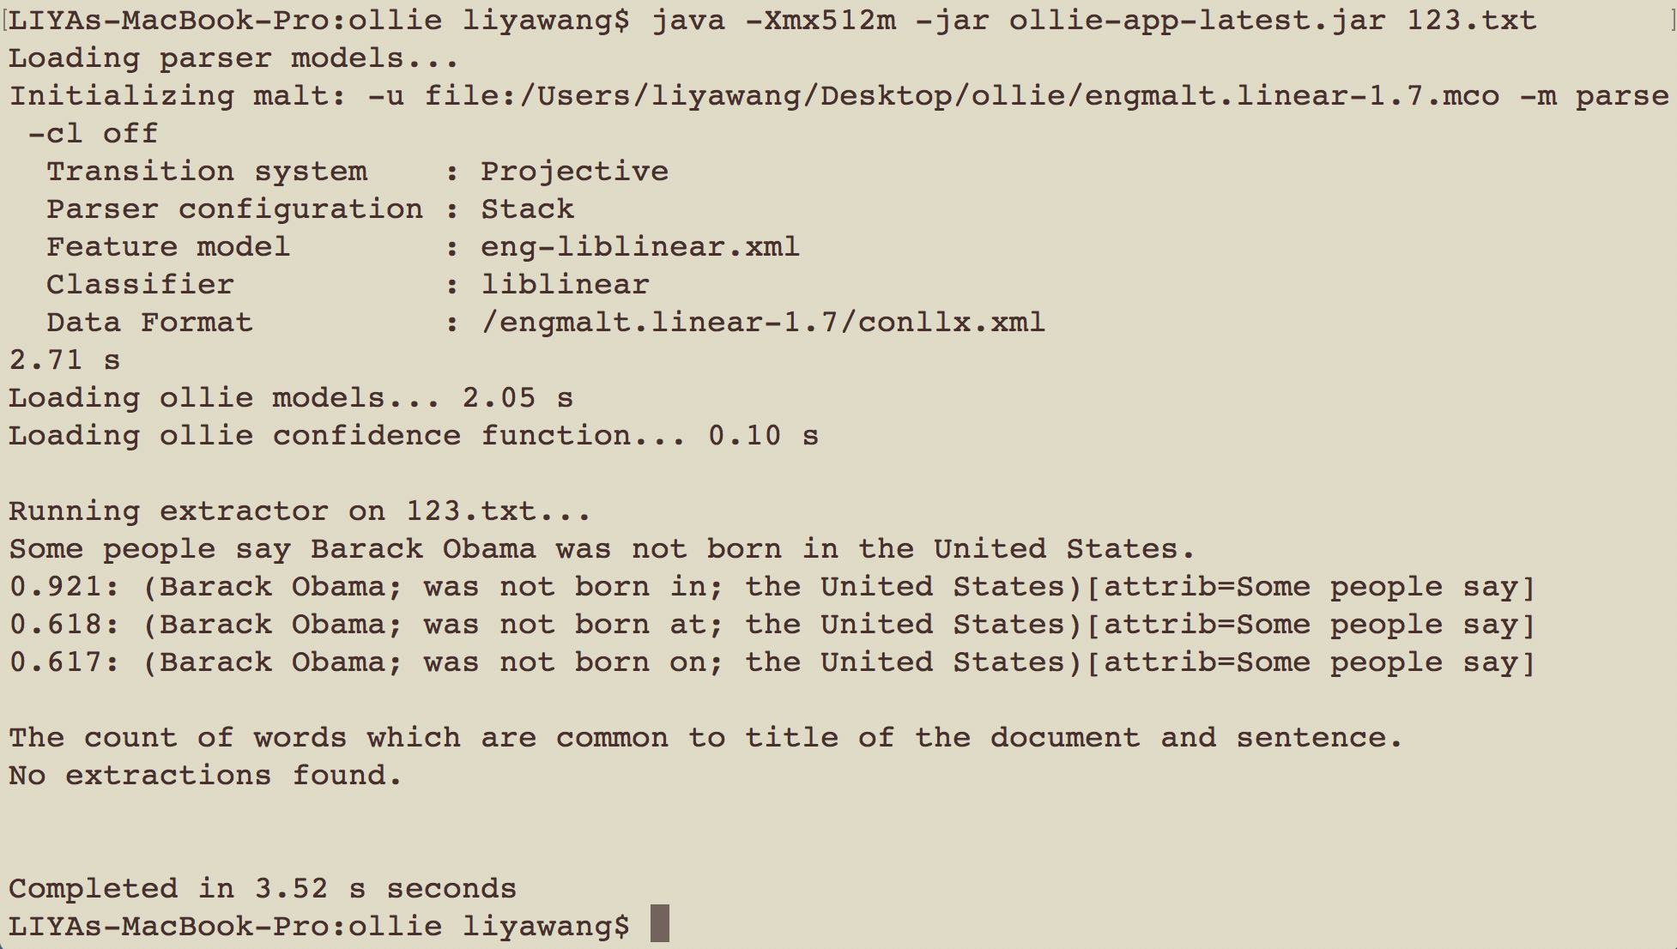
Ollie – Binary Relationship Extraction
Software running procedure:
Download the latest Ollie binary from http://knowitall.cs.washington.edu/ollie/ollie-app-latest.jar.
Download the linear English MaltParser model (engmalt.linear-1.7.mco) fromhttp://www.maltparser.org/mco/english_parser/engmalt.html and place it in the same directory as Ollie.
Run java -Xmx512m -jar ollie-app-latest.jar yourfile.txt. The input file should contain one sentence per line unless --split is specified. Omit the input file for an interactive console.
Testing example: With the same sentences tested by Reverb.
We can see in the right graph, the Ollie can analyze the
relationship in the first sentence, including the Attribution
relationship. However, the second sentence doesn’t have any
extraction, which is different from Reverb.
The result also includes analysis time. We can see the time is
larger than that in Reverb.
Github:
https://github.com/schmmd/ollie/blob/master/README.md
Homepage: https://knowitall.github.io/ollie/

Slide 6
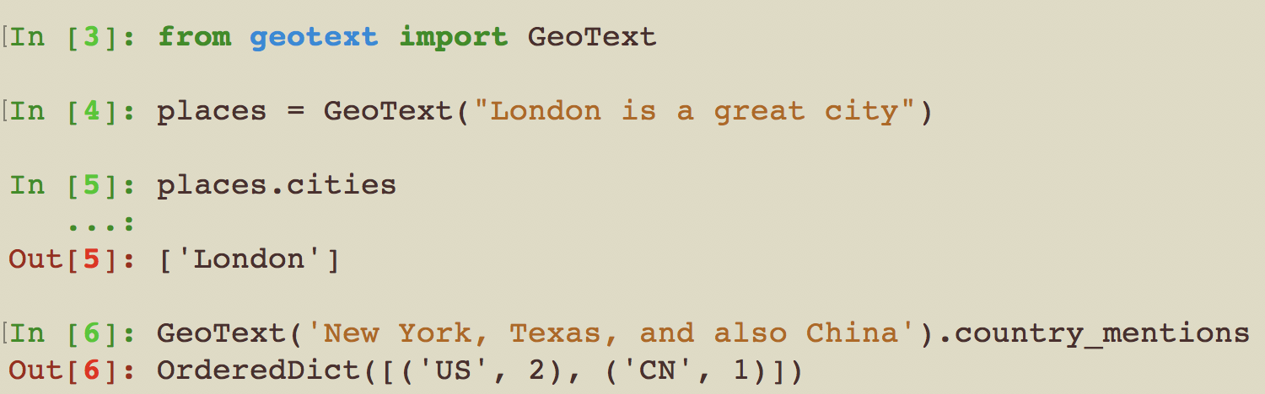
Geotext (Extracts country and city mentions in text)
Geptext is a software package written in Python, which can extracts country and city mentions from text.
The software running environment is in Python.
Pros: No external dependencies; Fast
Software running procedure (in the terminal):
easy_install geotext
ipython
from geotext import GeoText
places = GeoText("London is a great city")
places.cities
GeoText('New York, Texas, and also China').country_mentions
Testing example:
From right graph, we can see the Geotext can extract the country and city in the sentence. Meanwhile, GepText can also extract the number of country/cities
mentioned in a sentence in each country.
Homepage: https://geotext.readthedocs.io/en/latest/
Github: https://github.com/elyase/geotext
Similar projects
geography: geography is more advanced and bigger in scope compared to geotext and can do everything geotext does.
On the other hand geotext is leaner: has no external dependencies, is faster (re vs nltk) and also depends on libraries and data covered
with more permissive licenses.

Slide 7
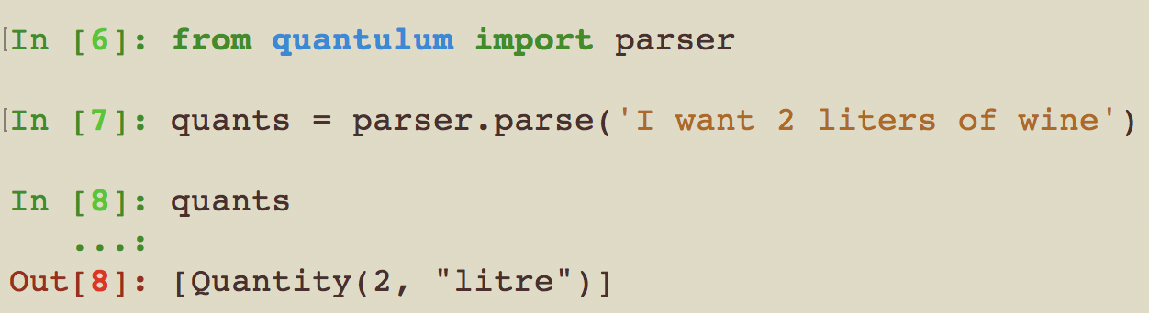
Quantulum (Quantities extraction from unstructured text)
Quantulum is a Python library for information extraction of quantities, measurements and their units from unstructured text.
The software running environment is in Python 2.7
pip: pip is a package management system used to install and manage software packages written in Python. Many packages can be found in the Python Package Index. Python 2.7.9 and later, and Python 3.4 and later include pip by default.
Software running procedure (in the terminal): The software needs to install sklearn first and then install Quantulum with pip installation.
conda update scikit-learn
pip install quantulum
ipython
from quantulum import parser
quants = parser.parse('I want 2 liters of wine')
quants
[Quantity(2, 'litre')]
Testing example:
From right graph, we can see with the parser in quantulum, the parser.parse function can extract quantities in the sentence, both the units and
measurement.
Sklearn Installation : http://scikit-learn.org/stable/install.html
Github: https://github.com/marcolagi/quantulum

Slide 8
Eventregistry (Accessing data in Event Registry)
Event Registry: Event Registry is a system that can analyze news articles and identify in them mentioned world events. The system is able to identify groups of articles that describe the same event. It can identify groups of articles in different languages that describe the same event and represent them as a single event. From articles in each event it can then extract event's core information, such as event location, date, who is involved and what is it about. Extracted information is stored in a database. A user interface is available that allows users to search for events using extensive search options, to visualize and aggregate the search results, to inspect individual events and to identify related events.
Eventregistry: is a Python package that can be used to easily access the data available in the Event Registry through the provided API. (run in python 2.7)
After signed in, you can get a API key from setting section, which is authorized that you can access the dataset in Event Registry.
My API key is "1af8ccea-4797-4989-b7a4-2f81bf43e126".
Software running procedure (in the terminal):
pip install eventregistry
In Jupyter (python 2.7)
import eventregistry
from eventregistry import *
YOUR_API_KEY="1af8ccea-4797-4989-b7a4-2f81bf43e126"
er = EventRegistry(apiKey = YOUR_API_KEY)
Event Registry Homepage: http://eventregistry.org/
Eventregistry Homepage: https://github.com/EventRegistry/event-registry-python/wiki
Github: https://github.com/EventRegistry/event-registry-python

Slide 9
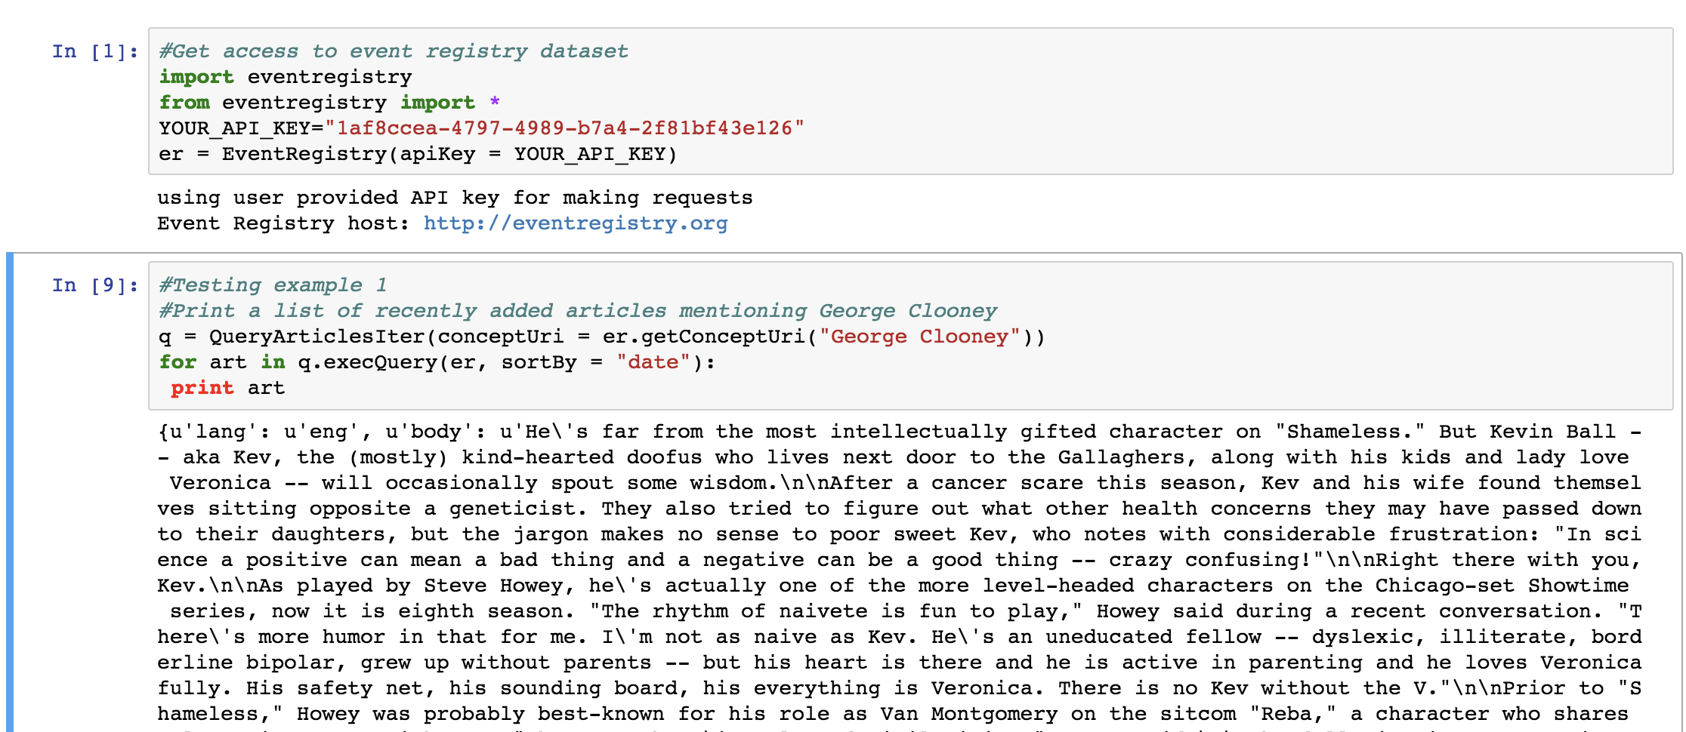
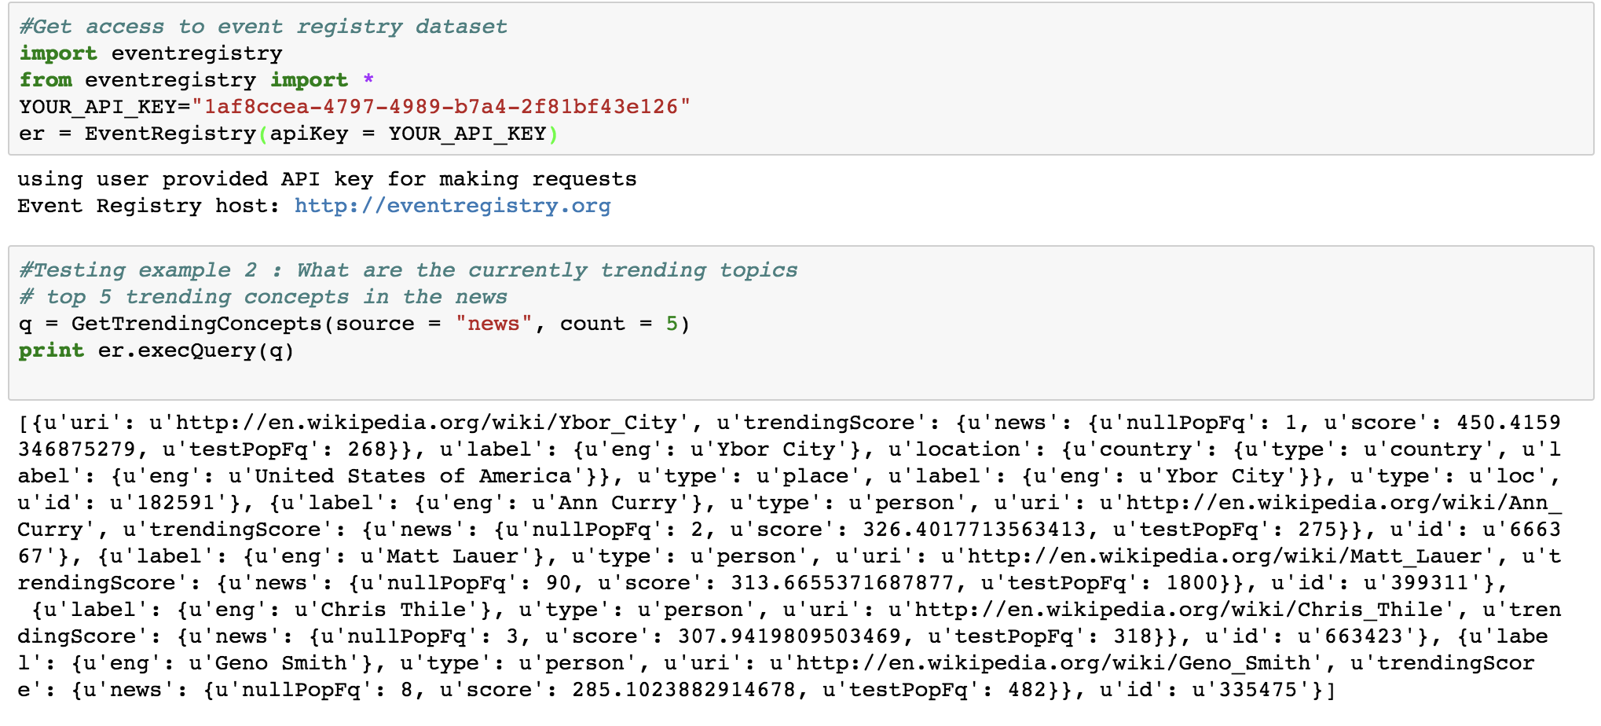
Eventregistry (accessing data in Event Registry)
Testing example 1 (In Jupyter (python 2.7)):
Print a list of recently added articles mentioning
George Clooney
q = QueryArticlesIter(conceptUri = er.getConceptUri…
…("George Clooney"))
for art in q.execQuery(er, sortBy = "date"):
print art
Testing example 2 (In Jupyter (python 2.7)):
What are the currently trending topics
# top 5 trending concepts in the news
q = GetTrendingConcepts(source = "news", count = 5)
print er.execQuery(q)
Analysis: From testing example 1 graph, through
eventregitry software package, we can get access to
Event Registry dataset and get the articles mentioned
‘George Clooney’ sorted by published date. Meanwhile,
We can also get the most popular topics and related articles
with URL and specific topics.

Slide 10
Issues & Difficulties
Issues: Though software packages mentioned above have many features and pros, they also have some issues.
ReVerb: Can’t deal with long-range relations. If the events and relationship don’t stay with each other, it is hard for ReVerb to find the relationship.
Oille: Be good at condition and attributes analysis, however, can’t analyzed sentence that has subordinate clause. (e.g. The count of words which are common to title of the document and sentence.)
Eventregistry: The results of returned articles are huge and mass without data source URL. I think it is better to
also offer the URL links so that the user can find the original articles.
Environment: Eventregistry can be just run in the Python 2.7 environment, but not Python 3.6.
Difficulties:
In this study, I found the installation methods are difficult for me.
For Quantulum, Sklearn is needed to be installed first.
For Eventregistry, I got stuck in Python 3.6.

Slide 11
References
pip (package manager). 2017. Retrieved November 29, 2017 from https://en.wikipedia.org/wiki/Pip_(package_manager).
Text mining. 2017. Retrieved November 29, 2017 from https://en.wikipedia.org/wiki/Text_mining.
Information extraction. 2017. Retrieved November 29, 2017 from https://en.wikipedia.org/wiki/Information_extraction.
Natural language processing. 2017. Retrieved November 29, 2017 from https://en.wikipedia.org/wiki/Natural_language_processing.
Eventregistry. 2017. Retrieved November 29, 2017 from http://eventregistry.org/.
Steven Bird, Edward Loper. (2009). Natural Language Processing with Python. O’Reilly Media, Chapter 7.
Banko, M., Cafarella, M., Soderland, S., Broadhead, M. and Etzioni, O. (2007). Open Information Extraction from the Web. University of Washington, pp.2670-2676.
Das1, T. and Kumar, P. (2013). BIG Data Analytics: A Framework for Unstructured Data Analysis. International Journal of Engineering and Technology (IJET), 5(1), pp.153-156.
Nasukawa, T. and Yi, J. (2017). Sentiment analysis: capturing favorability using natural language processing. Proceedings of the 2nd international conference on Knowledge capture, pp.70-77.

